Slide 3
Welcome
Bishop of Hereford
Rt Revd Richard Jackson

Slide 4
Introduction
Listening engagement and feedback
Discerning a new way forward
Our vision
Our core values
Challenges and Opportunities
The path to 2030 and beyond

Slide 5
Notes:
Circle of presenting issues: Buildings, fragile and disengaged, Age, Clergy morale and over-reliance, Finances
These five issues came up repeatedly as areas of concern in the listening exercises in the autumn of 2021.
Buildings, we have one building for every 800 people resident in the diocese. One deanery has a population of 12,000 and 37 church buildings – one for every 324 people! The best way to preserve a building is to have a vibrant worshipping community within it. Buildings are valued by their communities and partnerships are essential.
Fragile and disengaged: COVID has brought the crisis of 2025/6 home to roost in the now. A number of people have been lost over the last two years. Some are coming back, tired and unable to resume some of the vital lay positions needed to make the church operate. Inevitably, tiredness tend to make you focus inward on the familiar.
Age: The average Anglican outside of urban areas is 72. Many of our churches have very few people younger than retirement age. We need to re-connect not just with the young and children but those under 60.
Clergy morale and over-reliance: Clergy are increasingly having to take on roles for which they were not trained and to which they don’t feel called and gifted. This is demoralising and energy sapping. They would love to be spending more of their time in active ministry and pastoral and evangelistic work but the weight of compliance and loss of volunteers makes this difficult. As conscientious people they take a lot of responsibility upon themselves which amplifies the stress. Ephesians 4 says the role of ministers is to help the people be the church, not be simply a provider of religious services. In some places there needs to be a significant democratisation of ministry.
Finances. Finances are a symptom of a problem, not the problem itself. The issue is often asking for more money from less and less people. If our church was growing by people coming to living faith and joining us in worship, these issues would go away. If we get into a vicious spiral of having to cut clergy posts because of finance and that leads to people saying we see our clergy less so we will give less generously, we might as well pack up and go home now! We need to communicate the very full days our clergy have of which Sunday services are but a small proportion.

Slide 6
Notes:
Circle of things to address the issues from central diocesan resources
All these five can be addressed from inside the circle through parish revitalisation.
We have resources in the centre, some of which are provided for us by the national church in the form of grants form the Church Commissioners.
Buildings: continued support for fundraising. Support for festival church and if PCCs decide to close (they decide, the Bishop or Archdeacon cannot close a church) help with the process of closure. Working with the national church to explore and release new streams of funding.
Finances: continued help for efficient giving e.g. contactless, PGS etc. Maximising our asset development (current deficits have been sustained by successful glebe land development but that cannot go on forever). Getting more money from the national church to release some of our total return spend back into parochial ministry.
Clergy morale: a determined effort to raise the number of vocations to self-supporting ministry, enabling and encouraging a wider range of lay ministries, fostering a culture of permission giving rather than control.
Age: focus on our schools work and a continuation of the intergenerational mission project. Encouraging schools work and links between church and school. School chaplaincies funded by Church Commissioners funds
Fragility: A new diocesan mission enabler (funded by the national church) to walk alongside parishes and deaneries and help them formulate effective mission plans.

Slide 7
Notes:
Outside the ring – bold outcomes which we hope to see by 2030.
A clear future for every building and carbon neutrality as per the target of the national church
Breakeven budgets and sustainable finances across the diocese as a whole. This will mean the strong will continue to support areas of high deprivation.
A significant increase in the number of authorised and trained lay leaders and self-supporting priests.
A diocesan family whose age profile represent the communities it serves. This will mean a mixed economy of worshipping communities in schools, messy church, forest church etc.
A worshipping diocesan family that is 3% of the population of the diocese – 9000 people. Currently it is 6500 – a big, bold ask of the Lord. That’s 4 people to add to each benefice each year in addition to replacing those who are promoted to glory.
Conclusion: Romans 8: 28-30, “For those God foreknew he also predestined to be conformed to the image of his son, that he might be the firstborn among many brothers and sisters. And those he predestined, he also called; those he called, he also justified; those he justified, he also glorified.” (NB pre-destined doesn’t mean predetermined) This is a text of hope. God gives us the grace he need to step into the potential we have as made in the image of God and filled with his Holy Spirit.

Slide 9
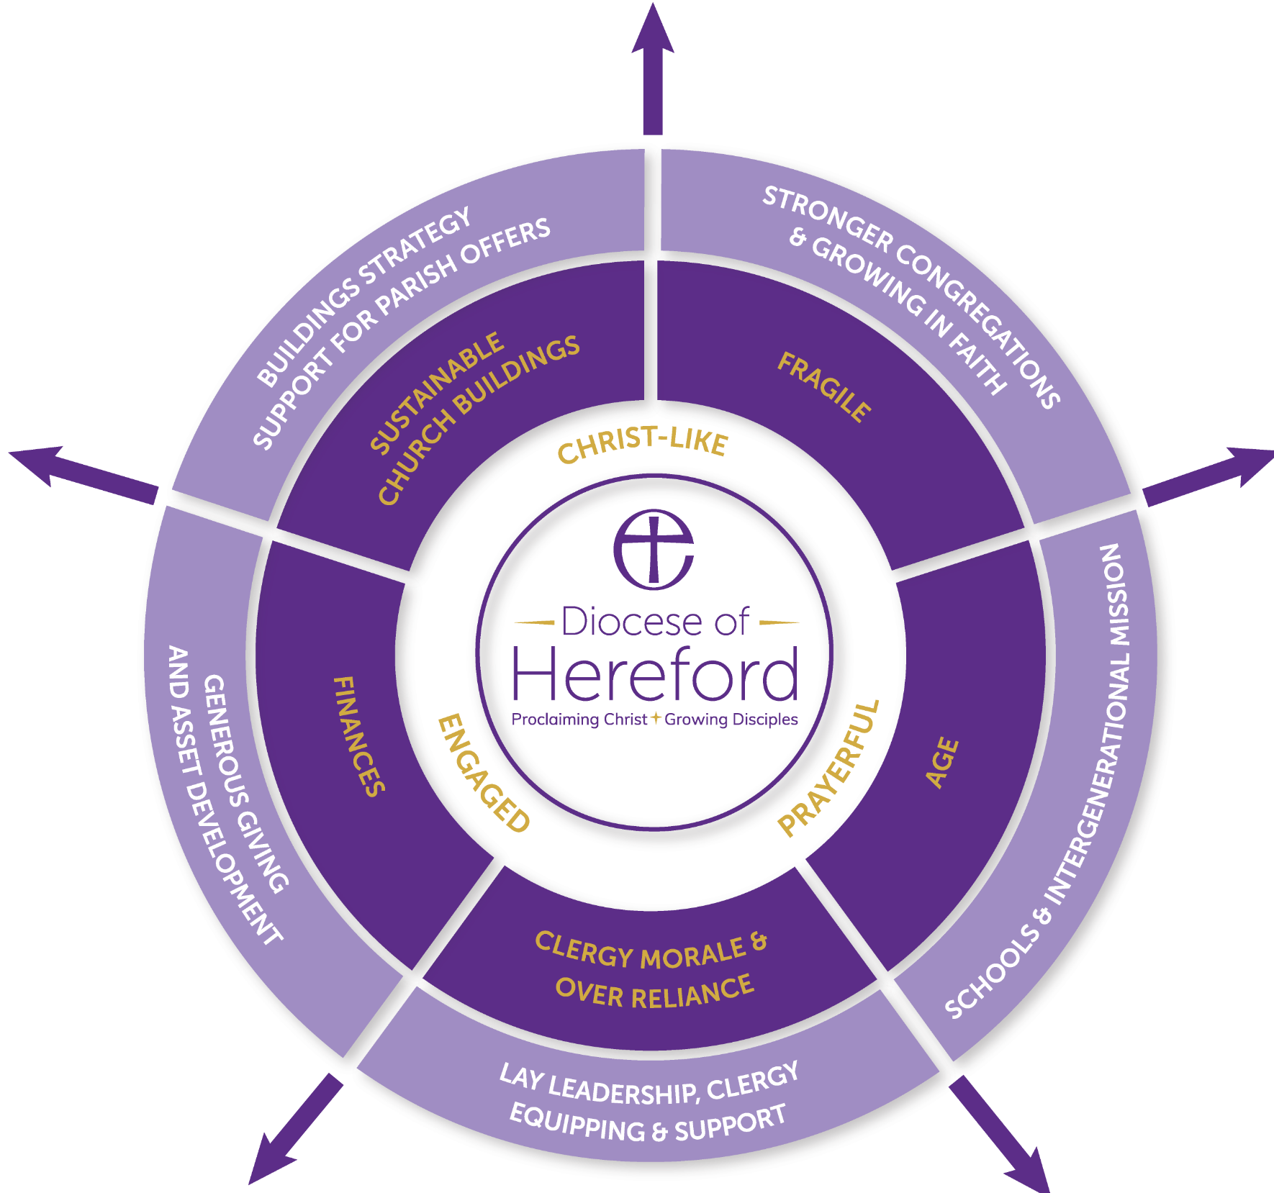

Slide 10
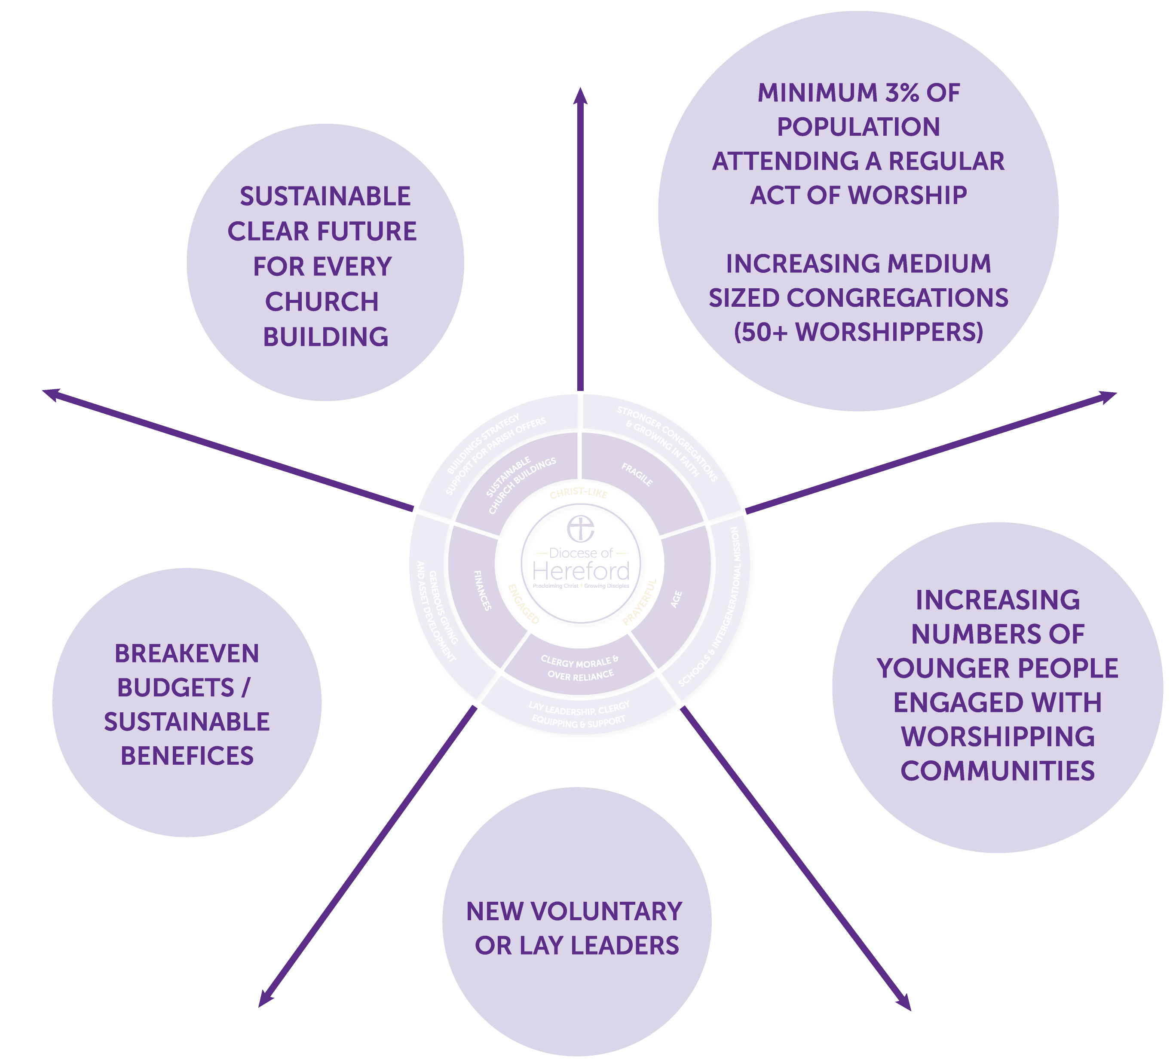

Slide 11
Response
Q&A Session

