Slide 2
2021 Listening Events
Our Diocesan Mission Action Plan / Strategy was created in 2016 after a series of 'Follow' Events around the diocese. In 2021 we wanted to know how successful it had been.
A theological think tank did some initial thinking at the start of the pandemic about what we were learning. Listening events were held online with all the clergy and readers. A strategy review group was set up.
Feedback from the initial suggestions from Strategy Review group concluded a longer period of listening was needed, especially as COVID was continuing to hamper any meaningful recovery planning.
Surveys were put on the website, people were encouraged to feedback directly or as part of teams and specific focus groups were set for underrepresented group (young people, teachers, female clergy). This sat alongside the 10 deanery listening events held around the diocese.

Slide 3
Main Findings
Throughout the events we received many concerns in a variety of formats but they broadly fell into the following categories:
Finances (sustainability, giving, offer)
Church Buildings (costs, use, maintenance)
Congregations (numbers, age profile, young people)
Clergy & Morale (tired, burnt out, some demoralised)

Slide 4
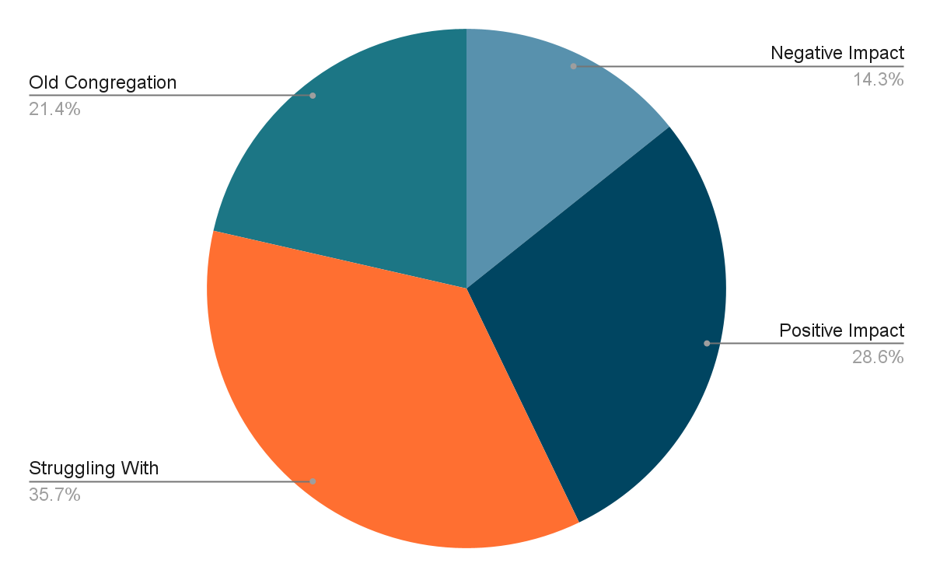
COVID and The Church
Many reported that they have struggled after COVID lockdowns with congregation not returning or not being able to find new members to join. However, some Parishes reported that COVID allowed them to branch into new forms of worship via Zoom and Online.
“Zoom services were amazing” –
Ross-On-Wye
“People not returning to the church, especially older people since covid 19” –
Bromyard Listening Event
“Not enough people to start new initiatives” –
Kington Listening Event

Slide 5
Funding and Finance
“Drop in income in some churches”
“Financial instability in churches"
“Anxieties over finance and the lack of generosity”
Bromyard Listening Event
Ross-On-Wye Listening Event
Abbeydore Listening Event
Difficulty with Finance and Funding featured heavily in every conversation.
Many people expressed real anxiety that they will not survive the next 5 years without more funding due to repairs or building updates needing to be completed for a safe environment to have church services within.

Slide 6
Demographics
Many rural parishes have very small congregations. Over 250 of our 402 churches having fewer than 20 people attending. People are very concerned for what the congregation numbers will be like in five years' time. They are also worried about the lack of volunteers for church roles
People also reported that it is the older generation that make up their congregations and this is a real cause for concern. Many believe the church will not survive without younger people (under 60!) joining the congregation but that there are too many barriers for them to join. Younger congregations might encourage more flexibility and wider engagement. A number also lamented the lack of men.

Slide 7
Comments
“We need more young people within the church” - Sutton Hill Listening Event
“Get rid of gatekeepers in the admin which stop the change from happening” - Ludlow Listening Event
“A diverse group of people learning in church – not stuck” - Leominster Listening Event
“How do we attract younger people into the church?” - Bromyard Listening Event
“Young people want to change things, Older people must avoid attitude” - Pontesbury Listening Event

Slide 8
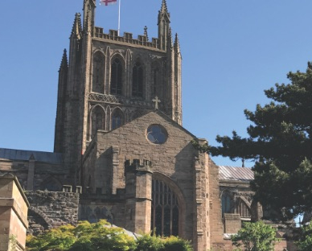
Building Concerns
Nearly everyone mentioned concerns relating to their church buildings.
People are concerned about:
the cost of maintenance,
historical listings,
the church closing
The lack of volunteers and
the lack of funding
Many Parishes are in need of repairs or better facilities to serve the community.
Some churches need:
toilets,
roofing repairs
technology such as wifi,

Slide 9
Has the last Strategy helped?
Many do not believe the previous strategy has helped their churches, many not even aware of what the strategy is. Below is a collection of quotes from some Parishes during the Listening Events.
“Not a meaningful guide but there wasn’t a follow-up or checking to see how it permeated” - Leominster Listening Event
“0-3 strategy hasn’t had an impact” - Kingston Listening Event
“The words of the strategy may not be used consciously but at Sutton Hill all the aspects have been at the heart of what the church is doing, including during the pandemic” - Sutton Hill Listening Event
“Most not aware of the strategy” - Pontesbury Listening Event

Slide 10
Clergy anxieties and worries
Feeling ill-equipped for the challenges, being asked to do a job for which they haven’t been trained.
Unrealistic demands from congregations and from ‘the diocese’
Sense of responsibility to keep the show on the road and to be positive when they don’t feel like it.
Sheer exhaustion. Operating out of the normal has drained energy and openness to new things.
Initiative phobia and cynicism – we’ve seen this all before and it didn’t make a difference then.
But still fundamental satisfaction in vocation.

Slide 11
Clergy anxieties and worries
“Lack of clarity of what was expected of clergy or lay” - Leominster Listening Event
“Accountability works both ways, up and down” Sacred Synod
“Strategy needs to be bottom up to engage congregations” Frequent comment
“Who are the ‘we’ and ‘our’ in the various strategy documents?” Clergy listening events

Slide 12
What do people want from their clergy?
Effective, accessible biblical teaching and liturgical competence
Teach spirituality, equip people to pray.
Enable and give permission for lay ministry, not holding stuff to themselves.
School involvement, especially assemblies.
Someone who pioneers links into the community.
Visibility.
Availability and approachability

Slide 13
What do people want from their clergy?
Quotes from Listening Events regarding the Clergy and Our Parishes worries and anxieties relating to the Clergy.
“Clergy to be more involved” - Ludlow Listening Event
“Are clergy happy/ready to leave their benefice / parishes to be rural pioneer priests “ - Abbeydore Listening Event
“Big issues e.g. both sides, clergy discipline – creates factions – does it help proclaiming Christ” - Pontesbury Listening Event
“Clergy resist being told what to do (as do some parishes)” - Hereford Listening Event

Slide 14
What do people want from central resources?
External facilitation for mission planning
Training for lay ministry
Appreciation, support and encouragement
Guidance for PCCs
DAC not just processing faculties but suggesting changes.
Transparency and communication about diocesan finance.
Reassurance about central cost control.
Help to encourage giving and capital fundraising.

Slide 15
Paradoxes and contradictions?
Established congregations lament the lack of younger volunteers to sustain the existing, younger people have no interest in sustaining the existing! Tension between institution and kingdom?
Current leaders focus more on the survival of the institution and preservation of existing patterns, some seeing talk of inclusivity and combatting racism as ‘woke’ distractions. Younger people see these things as the main thing!
Laity are asking for training and equipping to live the spiritual life, but still want in many cases clergy to do it for them. Clergy and Readers are bemoaning the lack of engagement with anything other than Sunday worship.
Parishes have money anxieties, yet parish reserves have increased markedly over the last few years and our buildings are in a better state than they have been since they were built.
A digital divide opening up between not spots and generations living more of their lives online.
We all seem agreed on the importance of climate change and engaging with it with other partners.
We want vision but we’re all exhausted.

Slide 16
Conclusions from strategy review group
Some agreed values:
Corporate prayer and worship the foundation of our activity.
Our calling is to proclaim Christ in word and deed, grow disciples and build the kingdom.
The people of God working together are our greatest resource.
Local Church congregations are the centre of the diocese.
We are all part of one body, whether parish or central resources.
The need for continuing development in the following areas:
Focus on Christ
Generosity
Co-operation
Community engagement

Slide 17
Final Overview
We can see that any strategy for 2022 onwards needs to look clearly at:
Growing congregations (A bigger church to make a bigger difference).
Meeting young people where they are and making connections (schools therefore central), but don’t forget the 20 -60 year olds!
Increasing clergy morale, confidence and capability.
Providing lay leadership support, diversifying training and possibilities for service
Our buildings.
Finding a way to be sustainable and talk honestly about money.
Permission giving and mutual accountability, bottom up rather than top down.
Flexibility – constant change is the new normal.
Raising people’s sights above the narrowly parochial.
Engaging with the 97%
Reframing language, but not dumbing down, discipleship is demanding.

Slide 18
Reflections
From what’s been said so far, is there anything missing?
Anything that you disagree with or would want re-framed?

Slide 19
Groups after lunch from DLTs*
Self select into groups according to interest.
Agreed values and continuing development (cultural shift), e.g. supporters to disciples of Christ
Engaging the 97%
Relationship between bottom up and top down – loose expectations rather than targets. How do we link up?
What is a Deanery Leadership team, how should it be authorised and resourced?
Review current provision
Are there things we should stop?
Are there things we should do differently?
How could the DLT help move this forward?
What help would we need from central resources to do this?
*Deanery Leadership Teams

Slide 20
Areas from BSM* and staff discussion
Self select into groups according to interest.
Schools strategy properly integrated into a diocesan strategy
Building clergy morale and capability
Equipping parishes and benefices to grow.
Communication around buildings/ money/ technicalities to grow confidence. (e.g. when to pick up phone to DAC, how to encourage giving etc.)
Enabling lay ministry alongside clergy.
Review current provision
Are there things we should stop?
Are there things we should do differently?
Is there anything new we should start.
*Bishop’s Staff Meeting

Slide 21
Next Steps
The development of our strategy will need to account for the anxieties, tiredness and insecurity in congregations, clergy and lay leaders as we slowly emerge from the pandemic.
Further development work needs to be done with the Bishops Council, Bishop’s staff and Diocesan Synod.
Further communication of the emerging direction of travel and prioritising of needs to be undertaken with all key stakeholders.
Aiming for a summary presented to Diocesan Synod in July 2022.
Plan to host events to communicate around the diocese in autumn 2022.
*Bishop’s Staff Meeting

