Slide 2
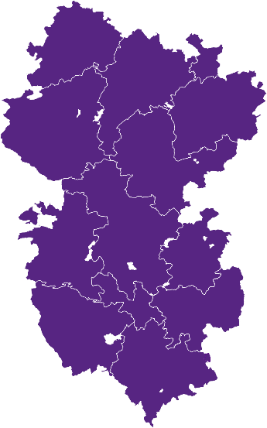
Profile of Diocese:
Key facts and figures
Population: 322,000 (40th of 41)
Attendance: 6,900 (40th of 41)
Attendance per Capita 2.1% (national average: 1.15%)
Number of Parishes (Churches)356 (405)
Number of Churches per Capita: 1:800 (1st of 41)
Giving per person per week £9.42 (41st of 41)
Population Density Rank: 41st of 41

Slide 3
Key Focus:
missional, people and financial challenges
Where are we now?
We face a critical challenge with mission and ministry:
Large number of declining churches
Aging population
Widely dispersed population over a large geographical area
Acute lack of children, and young people aged 11 to 18 in church

Slide 4
Key Focus:
missional, people and financial challenges
Attendance: figures have declined by 23% 2019-2022. Only 17 churches have over 50 people on Sundays. 250 churches have fewer than 20 people attending.
Demographics: outside towns, the average Anglican in the Diocese is aged 72. Very few children at most acts of worship (0.66% of the population). Over 12,000 children and young people attend our schools, but only 429 children (0-17) ‘usually’ attend church.
Budget deficits: Parish Offer has not kept pace with inflation, declining by 30% in real terms since 2019. We will have a structural operating deficit of c. £0.75-£1.0 million a year for the foreseeable future unless we grow income and reduce expenditure.
Leadership: There is an excessive reliance on clergy
Buildings: We have many church buildings (405) but many lack the capacity, energy and finances to realise their potential fully for local communities.

Slide 5
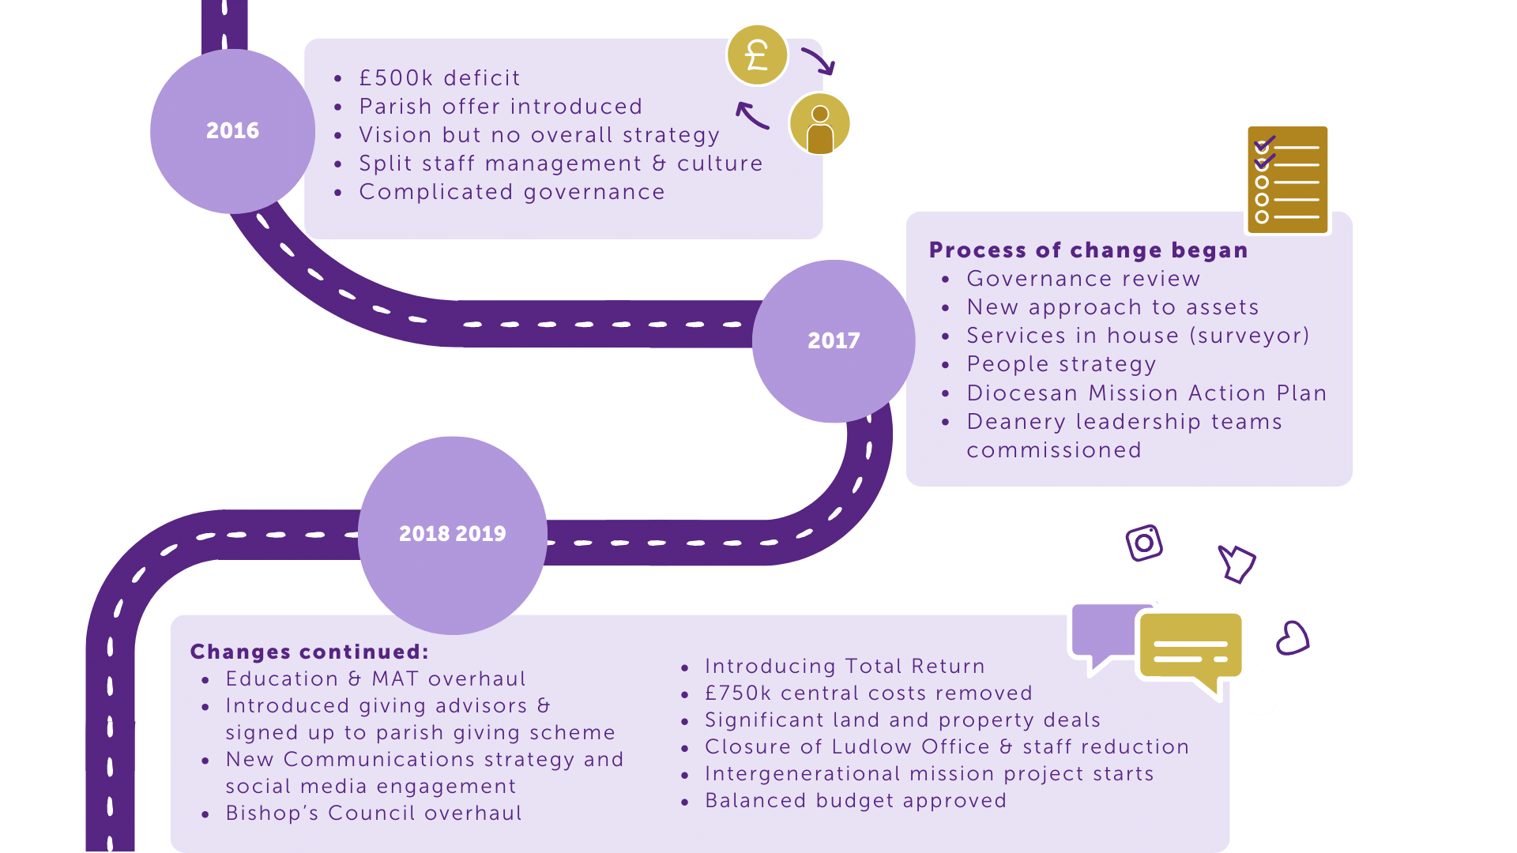
Our Journey:
Current approach to addressing challenges
Over the last few years we have been developing a strategy to address our critical challenges.

Slide 6
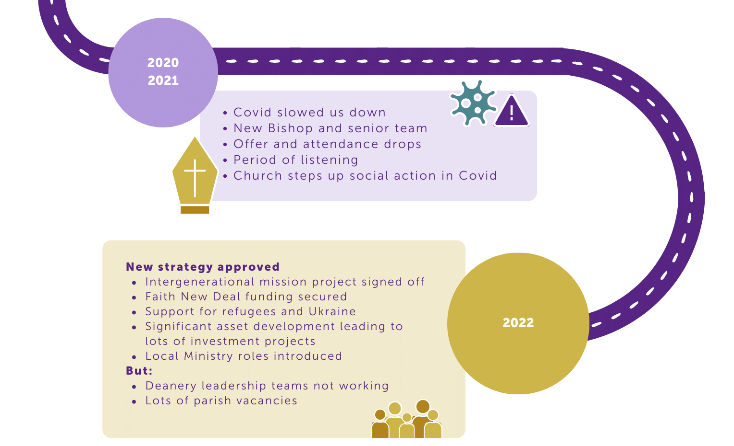
Our Journey:
Current approach to addressing challenges

Slide 7
Actions taken to date:
Current approach to addressing challenges
Intergenerational Mission: our five-year SDF project formed the first stage of a targeted cultural shift to support younger generations and nurture an emerging mixed ecology of congregations across our diocese.
Generous Giving Strategy & Mission Funding: around £1m released from capital investments for 16 growth projects focusing on increasing the number of children and young people in church.
Lay leadership training: refocused the Mission and Ministry team to provide greater support for Lay leadership and training, introduced Deanery training for commissioned Lay and self-supporting leaders, and deployed180 retired Clergy with permission to officiate.
Buildings: increased support for parishes to reduce the challenges and costs of their buildings.

Slide 8
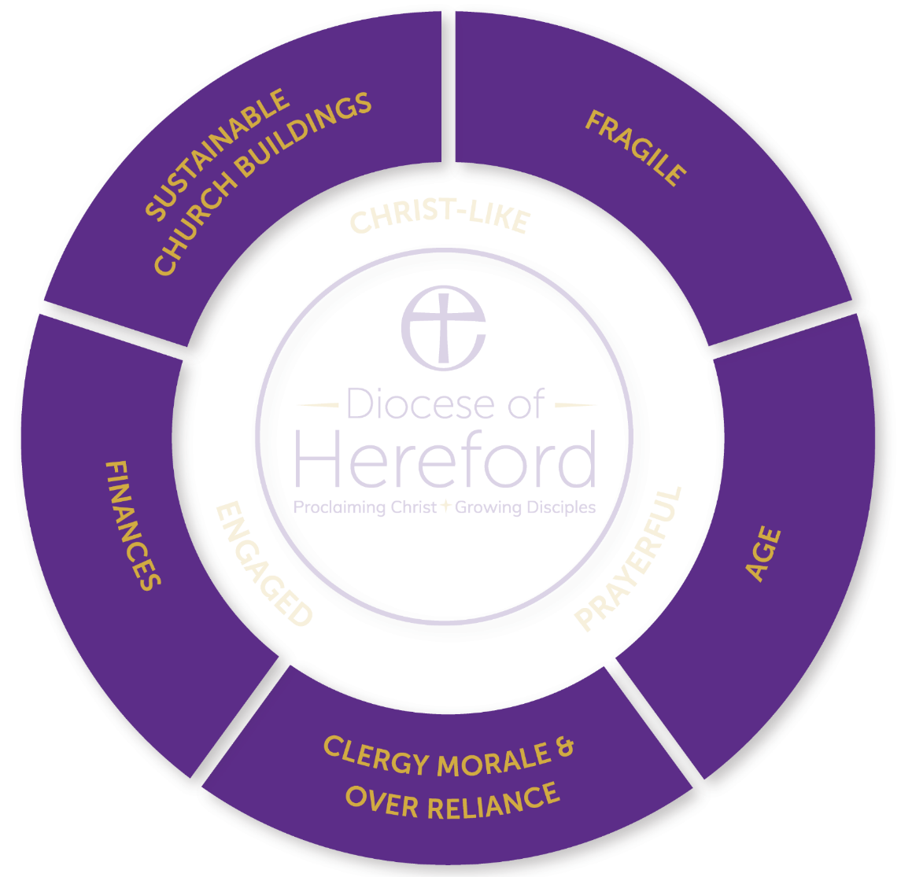
Notes:
Circle of presenting issues: Buildings, fragile and disengaged, Age, Clergy morale and over-reliance, Finances
These five issues came up repeatedly as areas of concern in the listening exercises in the autumn of 2021.
Buildings, we have one building for every 800 people resident in the diocese. One deanery has a population of 12,000 and 37 church buildings – one for every 324 people! The best way to preserve a building is to have a vibrant worshipping community within it. Buildings are valued by their communities and partnerships are essential.
Fragile and disengaged: COVID has brought the crisis of 2025/6 home to roost in the now. A number of people have been lost over the last two years. Some are coming back, tired and unable to resume some of the vital lay positions needed to make the church operate. Inevitably, tiredness tend to make you focus inward on the familiar.
Age: The average Anglican outside of urban areas is 72. Many of our churches have very few people younger than retirement age. We need to re-connect not just with the young and children but those under 60.
Clergy morale and over-reliance: Clergy are increasingly having to take on roles for which they were not trained and to which they don’t feel called and gifted. This is demoralising and energy sapping. They would love to be spending more of their time in active ministry and pastoral and evangelistic work but the weight of compliance and loss of volunteers makes this difficult. As conscientious people they take a lot of responsibility upon themselves which amplifies the stress. Ephesians 4 says the role of ministers is to help the people be the church, not be simply a provider of religious services. In some places there needs to be a significant democratisation of ministry.
Finances. Finances are a symptom of a problem, not the problem itself. The issue is often asking for more money from less and less people. If our church was growing by people coming to living faith and joining us in worship, these issues would go away. If we get into a vicious spiral of having to cut clergy posts because of finance and that leads to people saying we see our clergy less so we will give less generously, we might as well pack up and go home now! We need to communicate the very full days our clergy have of which Sunday services are but a small proportion.

Slide 9
Notes:
Circle of things to address the issues from central diocesan resources
All these five can be addressed from inside the circle through parish revitalisation.
We have resources in the centre, some of which are provided for us by the national church in the form of grants form the Church Commissioners.
Buildings: continued support for fundraising. Support for festival church and if PCCs decide to close (they decide, the Bishop or Archdeacon cannot close a church) help with the process of closure. Working with the national church to explore and release new streams of funding.
Finances: continued help for efficient giving e.g. contactless, PGS etc. Maximising our asset development (current deficits have been sustained by successful glebe land development but that cannot go on forever). Getting more money from the national church to release some of our total return spend back into parochial ministry.
Clergy morale: a determined effort to raise the number of vocations to self-supporting ministry, enabling and encouraging a wider range of lay ministries, fostering a culture of permission giving rather than control.
Age: focus on our schools work and a continuation of the intergenerational mission project. Encouraging schools work and links between church and school. School chaplaincies funded by Church Commissioners funds
Fragility: A new diocesan mission enabler (funded by the national church) to walk alongside parishes and deaneries and help them formulate effective mission plans.

Slide 10
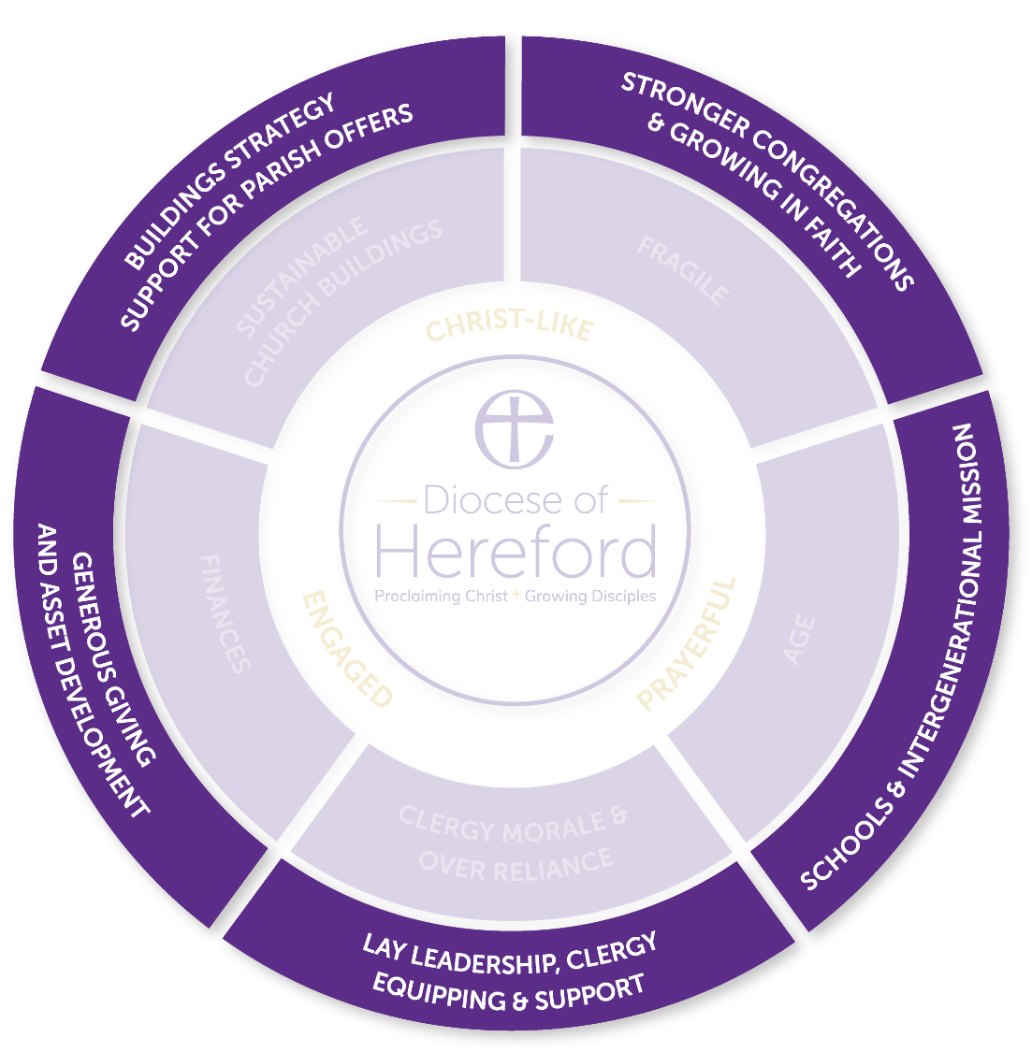
Notes:
Outside the ring – bold outcomes which we hope to see by 2030.
A clear future for every building and carbon neutrality as per the target of the national church
Breakeven budgets and sustainable finances across the diocese as a whole. This will mean the strong will continue to support areas of high deprivation.
A significant increase in the number of authorised and trained lay leaders and self-supporting priests.
A diocesan family whose age profile represent the communities it serves. This will mean a mixed economy of worshipping communities in schools, messy church, forest church etc.
A worshipping diocesan family that is 3% of the population of the diocese – 9000 people. Currently it is 6500 – a big, bold ask of the Lord. That’s 4 people to add to each benefice each year in addition to replacing those who are promoted to glory.
Conclusion: Romans 8: 28-30, “For those God foreknew he also predestined to be conformed to the image of his son, that he might be the firstborn among many brothers and sisters. And those he predestined, he also called; those he called, he also justified; those he justified, he also glorified.” (NB pre-destined doesn’t mean predetermined) This is a text of hope. God gives us the grace he need to step into the potential we have as made in the image of God and filled with his Holy Spirit.

Slide 11
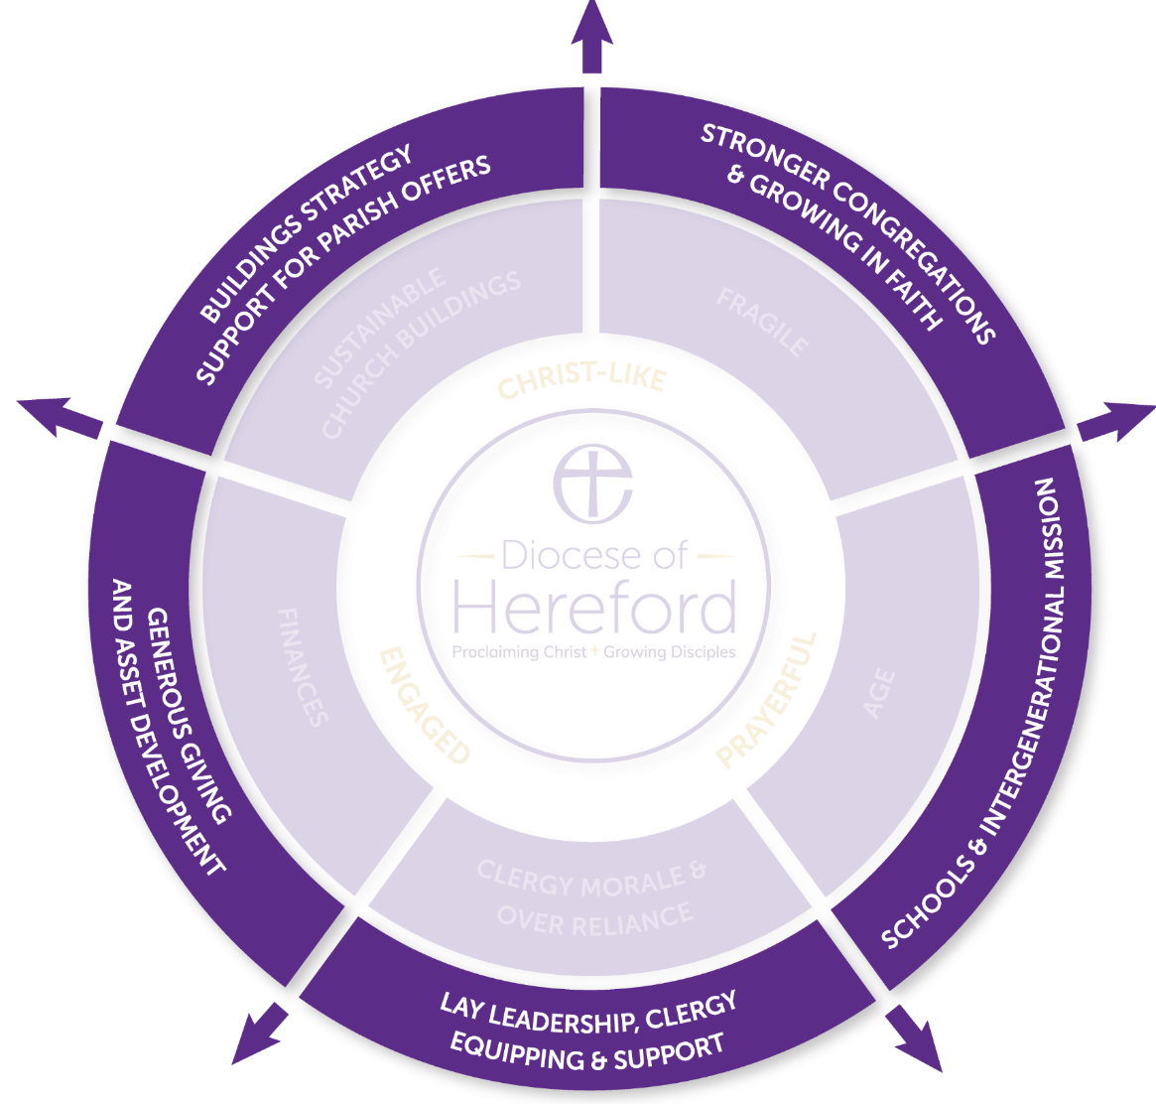

Slide 12
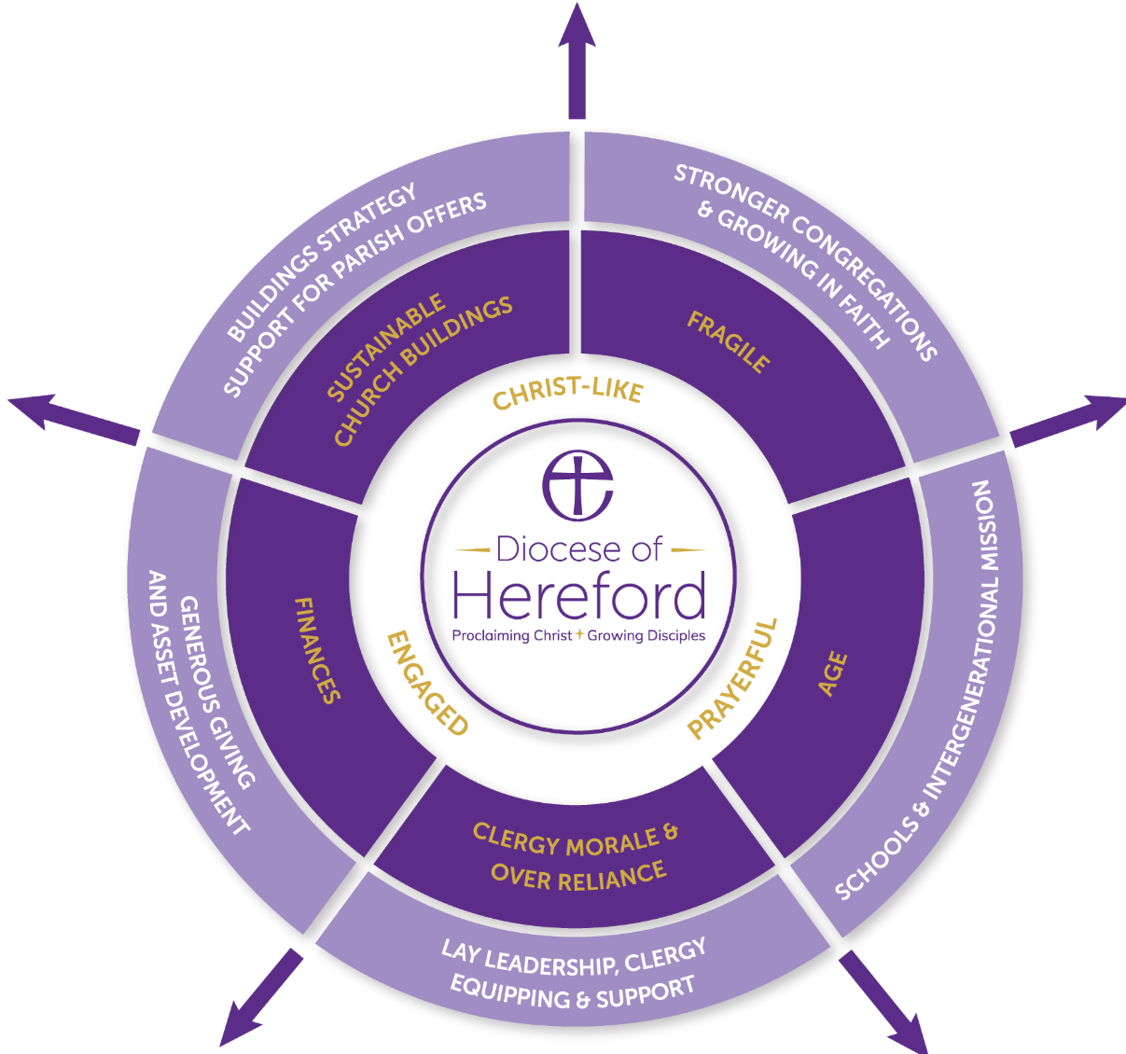

Slide 13
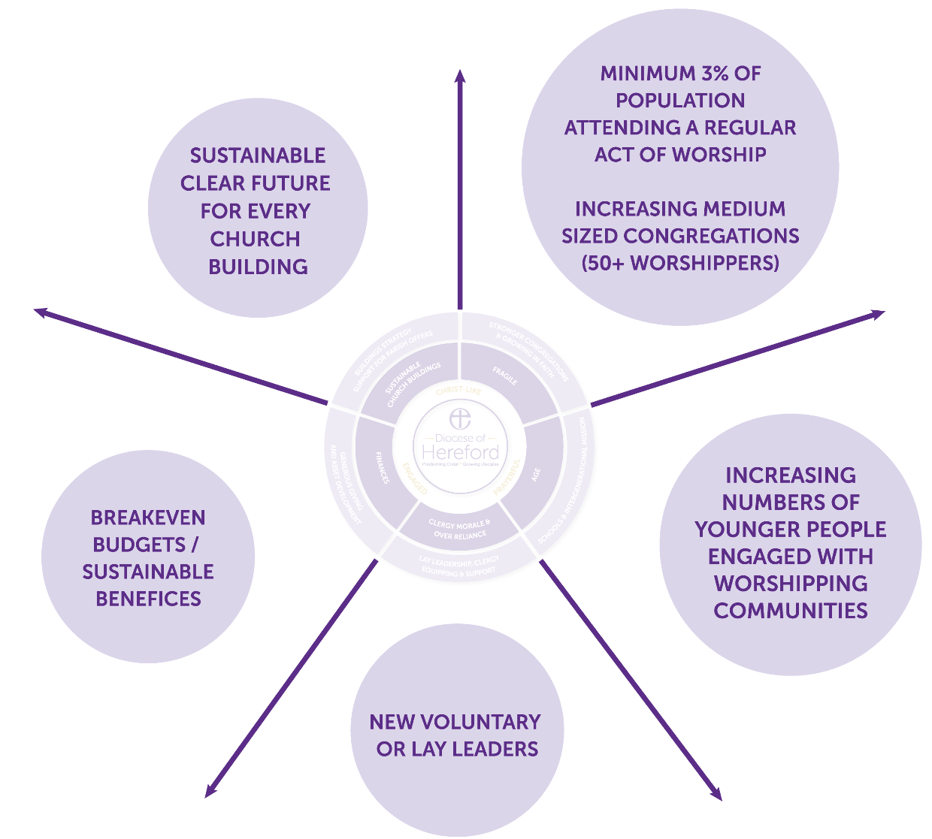

Slide 14
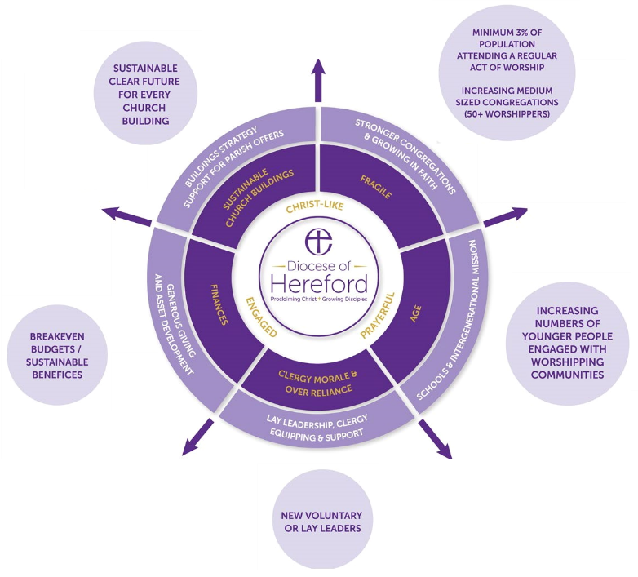

Slide 15
Our Plan:
Missional Vision & Strategic Framework for Change
Double the number of young people attending worship from 500 to 1000.
50 New Worshipping Communities, with 25 focused on young people.
50+ of benefices to have at least one congregation with an attendance of over 50 in rural areas and over 100 in market towns.
More than 3% of the population (9,500) attending regular worship.
Equipped and well supported lay and ordained leaders enabling a Christian presence in every community.
200+ new voluntary lay leaders.
75% of benefices to be sustainable: with a practical strategy to manage buildings & finances.

Slide 16
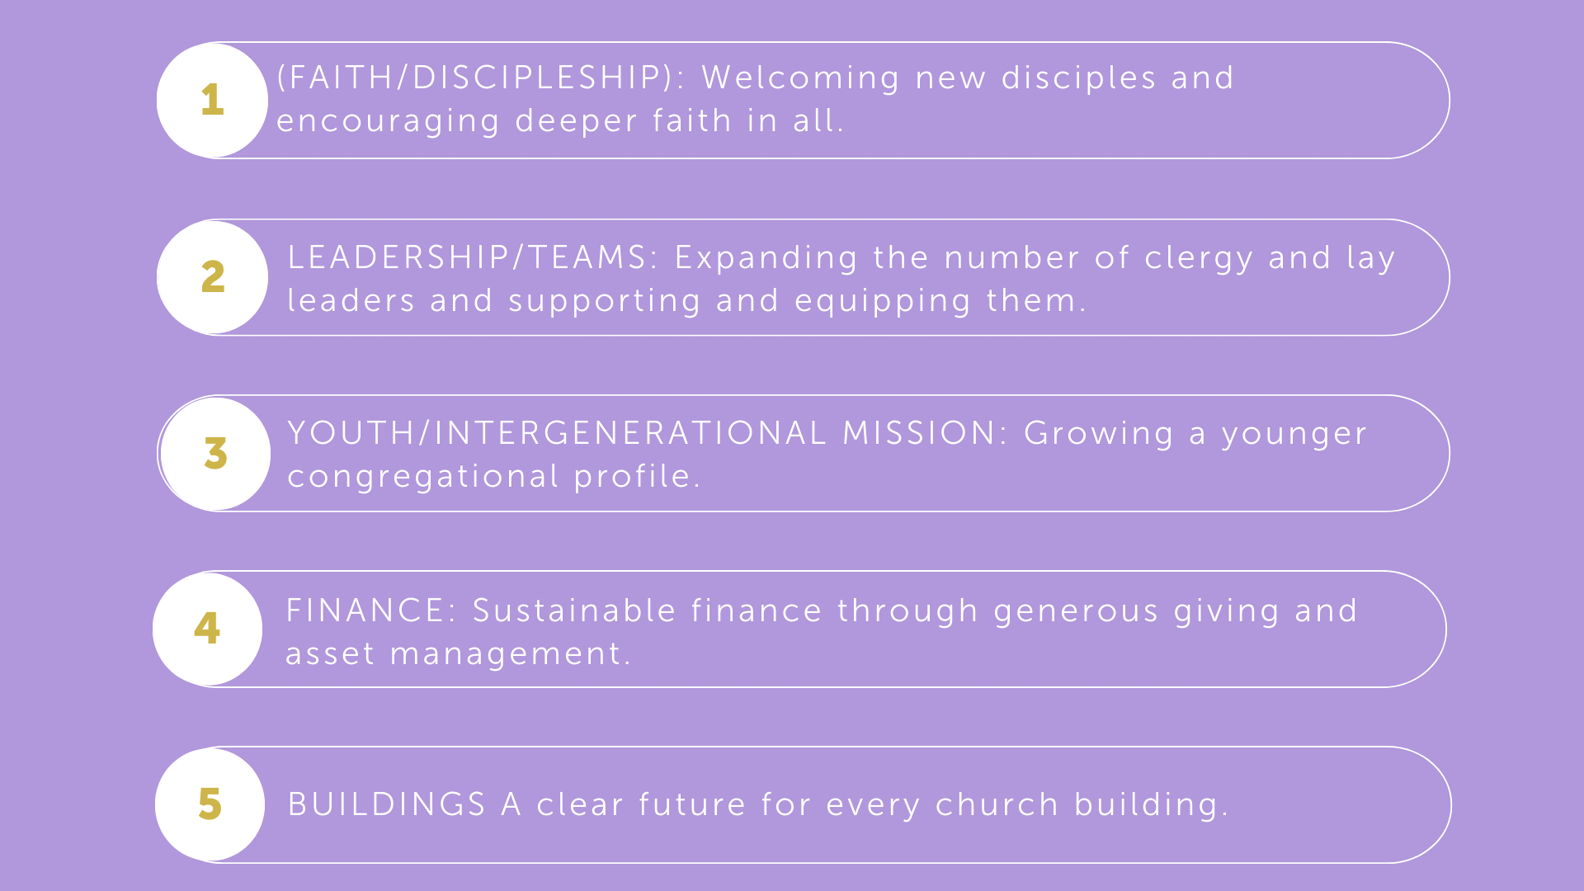
The Future:
missional priorities

Slide 17
The Future:
missional priorities
“We will focus resources on a smaller number of larger places with the greatest potential for impact by creating 7 Ministry areas with a core of at least 50 strong, growing churches.“

Slide 18
The Future:
missional priorities

Slide 19
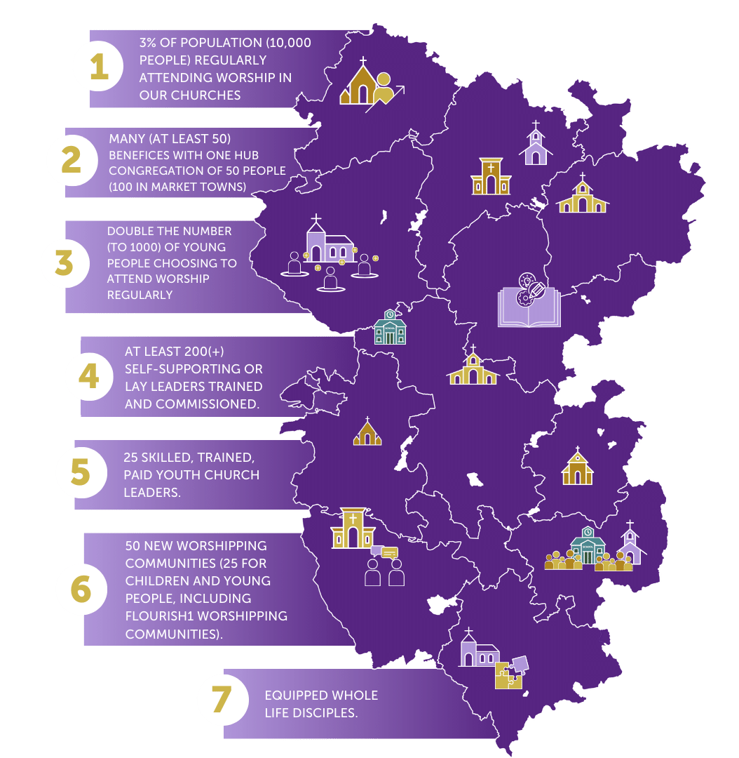
The 7 bold outcomes that we expect to see by 2030 across our diocese

Slide 21
Key Focus: Youth Hubs Pilot
Strategic investment from the National Church Institution in helping us to grow younger in Hereford Diocese

Slide 22
Key focus:
Youth Hubs – Pilot Project
A 3-year pilot testing an innovative ‘Hub and Spoke’ approach to mission and evangelism with young people which we believe is an effective model to respond to the significant challenges of our dispersed rural context. This will bring about a step-change in youth ministry for the Diocese of Hereford and offer a model for rural ministry across the Church of England.

Slide 23
Key focus:
Youth Hubs – Pilot Project
As a result of the pilot we are confident we will see:
6 new youth-focussed worshipping communities
120 young people making significant steps of faith and/or commitments.
180 young people regularly attending a Worshipping Community
20 licenced/commissioned new youth leaders
10 new ‘young leaders’
1000 young people accessing Youth Ministry
Two mission areas revitalised for mission with young people

Slide 24
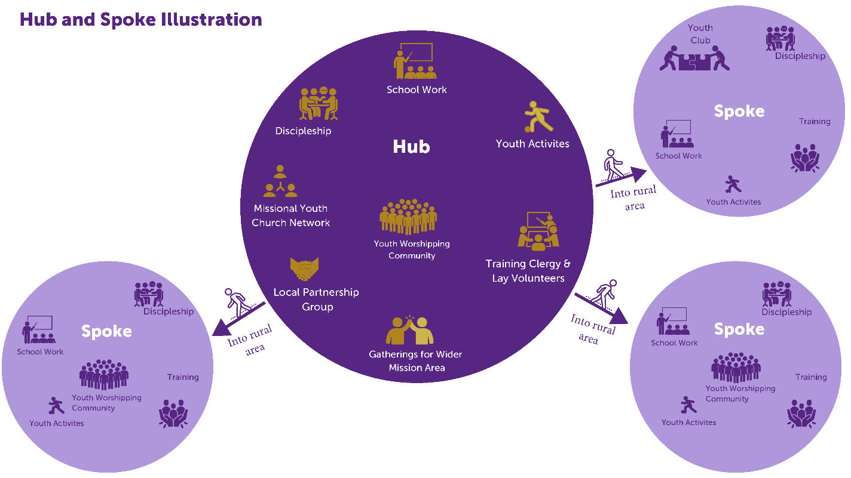
Key focus:
Youth Hubs – Pilot Project
Hub:
Hub: a new worshipping community in an area of strategic opportunity, with a supporting theory of change and discipleship pathway connecting young people through community and schools abased activities, with a ‘pathway’ of activities and events supporting evangelism, faith, discipleship, and leadership. The Hub will be the centre for training in youth ministry. Hubs will have local PCC ownership with accountability and oversight through a Local Partnership Group drawn from local and diocesan representation..

Slide 25
Key focus:
Youth Hubs – Pilot Project
Spoke:
The Hub ‘Spokes’ reach the surrounding rural area with inspiration, training, innovation and development support for smaller scale but well-connected youth engagement and smaller worshipping communities in the surrounding rural area. These will reflect the natural networks of young people through school, college, and social activities

